Slide 1
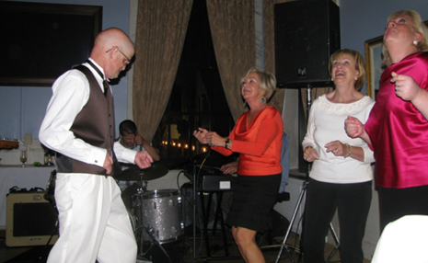
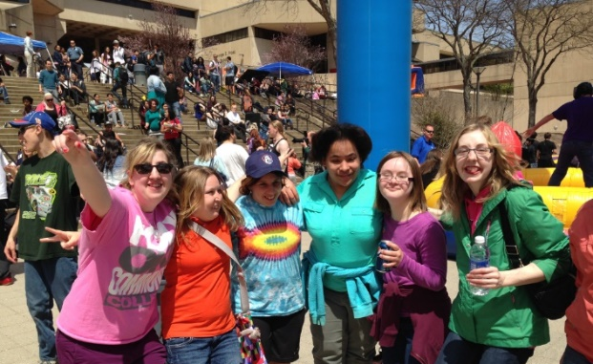
INTRODUCTION TO FRIENDS: Supporting FRIENDSHIPS Between People with and without Disabilities
Prepared by Widening The Circle; Pathways to Friendship, a partnership between The Arc of Massachusetts and Massachusetts Department of Developmental Services
Follow us on Facebook and Social Media
#PathwaystoFriendship
Notes:
The relationships that people with disabilities have with their family members, paid staff and other people with disabilities are very important. But we should be working towards widening the circle of friendships to support those relationships to happen between people with disabilities and others in the community who are not family members, are not paid and may not also have disabilities. Because of our society’s continued reliance largely on services/supports that segregate people with disabilities from regular community life and congregate people together based on their disability, this can be challenging. But it is very worthwhile.
The training is designed so that it can be presented to one audience with an interest in a wide variety of ages, or it can be used for audiences specifically interested in resources for Kids, Transition-Aged Youth or Adults. The material has proven effective with audiences of human services staff, educators, students, parents/family members and people with disabilities themselves. Ideally this training would be conducted by a pair or small team of facilitators, with and without disabilities.
Typical audiences will be adults who may be parents/other family members, human services staff, people with disabilities or other interested parties. Understanding adult learning principles is the key to a successful training that engages participants and facilitates learning. Adults respond best to learning that is:
•Active •Experience-based •Recognizing the learner as an expert •Independent •Real-life centered •Task-centered •Problem-centered •Solution-driven •Self-directing •Internally and externally motivated
Some helpful adult learning concepts you can practice include:
•Dialogue - interaction between learners and instructors.
•Supportive atmosphere - a comfortable environment facilitates learning along with a nurturing instructor.
•Encouragement of cooperative communication - clear opportunities for discussion between learners and instructors and learners amongst each other.
For a fun way to learn more about Adult Learning Principles, go to “Adult Learning In Under 3 Minutes” at https://www.youtube.com/watch?v=8lvkJhXnEZk
Material/Equipment Needed:
-Easel/Wallpaper/Masking Tape or White Board
-Colored Markers
-Digital Projector
-Screen
-CD/”Flashdrive”/Laptop device with PowerPoint
Handouts/Samples that May be Helpful:
-Advocate newsletter articles:
-”How to Use Your IEP to Promote Connections and Friendships (if your audience includes people interested in children/youth with IEPs)”
-”How to Use Your ISP to Promote Connections and Friendships (if your audience includes people interested in adults who have ISPs)”
-”Strategies for Direct Support Professionals to Promote Friendships Between the People They Support and Unpaid People without Disabilities in the Community” (If your
audience includes DSPs)
-Sample Toolkits
-other sample material
Advance Preparation:
Arrive early and…
Be sure that all equipment for displaying slides is working properly.
Prepare headings for the 3 activities using wall-paper.
This “Facilitator’s Guide” is intended to be used with an accompanying PowerPoint slide show.
The material is designed to be easily adaptable for your purposes as a trainer. For instance, you may want to customize the material (pics and script) to use as an orientation for new staff. Or maybe you’re active in a Special Education Parent Advisory Committee and want the material to reflect just school-aged children. Or maybe you are a member of a self advocacy group and want to create a presentation on this topic that’s really exciting for members of your group. We encourage you to adapt this material as you see fit, AS LONG AS YOUR MESSAGE EMPHASIZES THE VALUE OF SUPPORTING FRIENDSHIPS BETWEEN PEOPLE WITH AND WITHOUT DISABILITIES!

Slide 2
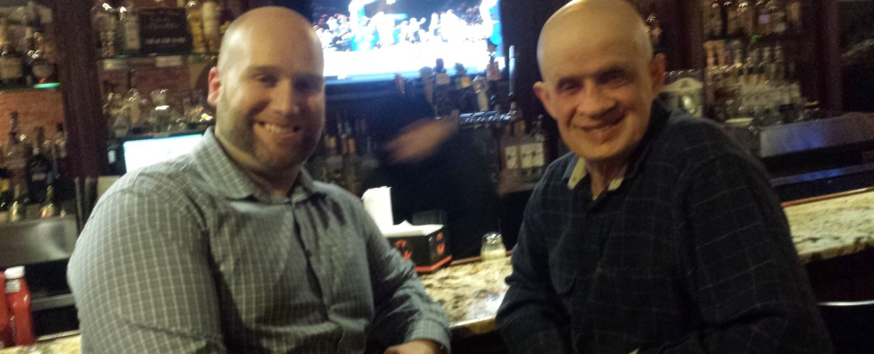
OBJECTIVES OF THIS TRAINING
Define “friendship”.
Understand specific benefits of friendships.
Be able to identify and explore common challenges in making friends.
Understand the importance and impact of “belonging”.
Discuss strategies to support someone to establish/maintain a friendship.
Notes:
This 2-hour training has been developed as part of the DDS-funded “Widening the Circle Project” through The Arc of Massachusetts.
Facilitators Note The GOAL of this training is to help people with and without disabilities, their families and supporters to better understand the importance of friendships between people with and without disabilities. Specific OBJECTIVES include:
Participants will be able to define “friendship”.
Participants will be able to list specific benefits that friendships bring into everyone’s’ lives.
Participants will be able to identify and explain obstacles to the development of friendships between people with and without disabilities.
Participants will be able to develop a plan strategies to support someone to establish/maintain friendships.

Slide 3
Meet Someone New
What is their name?
Where do they live?
What do they like to do for fun?
Notes:
Facilitator’s Note Conduct an activity to introduce participants. Use the one below or some other activity that meets your needs. Some alternative activities are available in the “Trainers’ Corner” of the Widening the Circle” website at:
http://thearcofmass.org/programs/widening-the-circle/trainers-corner/
Ask people to pair up and get the information from the slide from their partner. After a few minutes, approach one pair and ask one of them to introduce the other to you, the facilitator. When that is done, as the other person in the pair to introduce their partner to you. When the first pair has completed their introductions go to the next pair and then to the next. With a small group, you can do this with everyone. With a larger group you will need to limit this activity to 5-6 pairs of participants.
As you are being introduced, be sure to use good social interaction such as eye contact, a hand shake, head nodding, paraphrasing, etc. Also, any time someone says something that might connect them to a previously introduced participant (from same/neighboring towns or shared fun activity) note that out loud and introduce those people briefly to each other.
After the introduction activity is complete, ask participants why you did this particular activity at this particular training. Their answers should include:
1. in their work/personal lives, participants may need to help facilitate introductions between people with and without disabilities. If so, they need to be sure to role model good social interaction skills.
2. To help people make connections with others you need to know them well. Find out as much about the person(s) you care about as possible.
3. Keep your eyes & ears open to things that people might have in common. Sharing a community or a common interest can be very good first steps towards a relationship that—with the right supports—could blossom into a friendship.

Slide 4
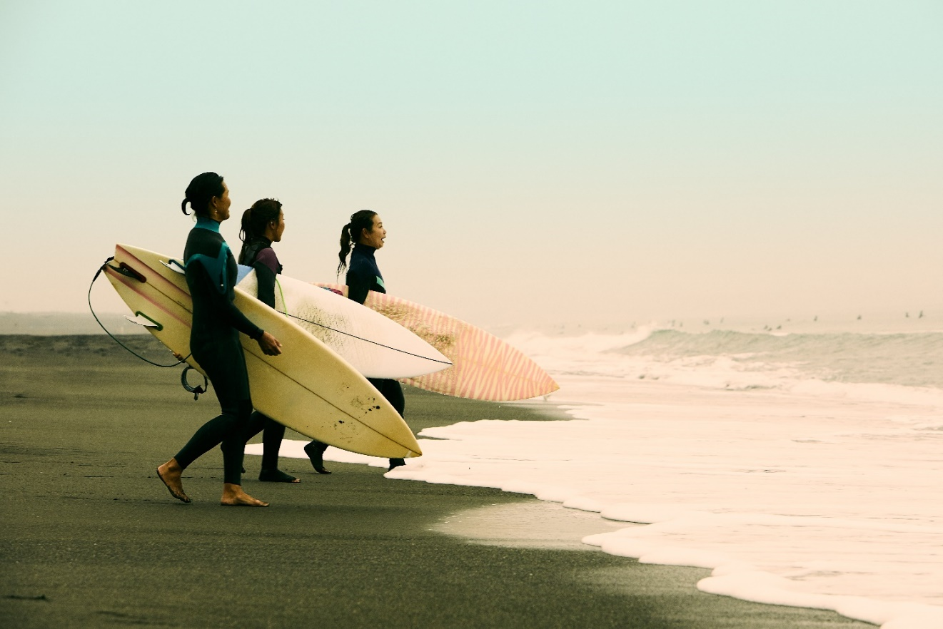
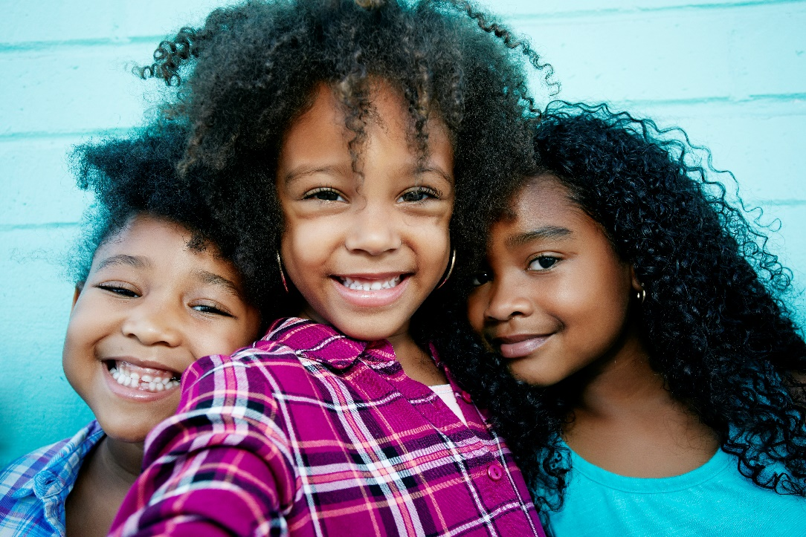
Best Friends!
Who is your best friend? (not a relative)
How long have you been friends?
Where/how did you meet?
How do you keep your friendship going?
Notes:
Facilitator’s Note: The purpose of this activity is to demonstrate that we all have friends (not including family) in our lives who are very important to us. How long folks have been friends and where/how they meet varies. Through this exercise we want to point out that there is no time limit on when to make friends and there is no one place to meet someone new. While it’s true that some friendships are seasonal others are enduring. Even in those seasonal friendships there likely are wonderful memories and perhaps extraordinary experiences.
It’s important to remind people that when someone they support has or finds a friend, this is a relationship that needs attention and preserving.
Through the group’s personal sharing we want to demonstrate friends can be made at any age and can be found in any number of places. The larger your group the more variety you will have answers. Keep a log of answers as to where and how folks met so you may add what you’ve heard from others, especially if they are unique situations e.g. Cheerleading camp or Scuba Diving.
Bottom line, people aren’t likely to meet new people and have new experiences without getting out there and engaging.
Ask participants to write the first name of their friend on a large colored index card. You may have folks tape their cards on the wall, forming a friendship collage of color. However, this does take and can be distracting.
You or a helper can list on board or flip chart the # of years folks have been friends. Hopefully you will get a range from months to decades.
Similar to #2 list the ways people met. Typical group responses –
School (sports, classes, chorus, theater)
Church (dinners, events, services, projects)
Sports (team events, learning a new sport)
Neighborhood (next door, Mom’s friends, friends of friends)
Work (co-worker, supervisor, supervisee)
Compare the experiences of the group with the traditional experiences/involvement of people with disabilities. The comparison will likely illustrate a significant difference that, with some intentional care, can be altered by enriching the lives of people with disabilities through belonging and friendships.
Close this activity by reminding people that each name on the board is someone very important to them, someone who has made their life a little better. Ask them to imagine what they would have missed if that person had not been in their life. The treasure of friendship!
This exercise and the rest of this training will hopefully reinforce the importance of relationships and friendships for folks with disabilities beyond family and the human service world.

Slide 5
Characteristics of a Friend
Helpful
Honest
Funny
Caring
Brave
Loyal
Generous
Creative
Notes:
Facilitator Note: These next 3 segments (“What are Characteristics of a Friend, of Friendship” and “What are the Acts of Friendships”, can be presented in a couple of ways, depending on class size and time limits. You can conduct each segment as a large group activity, identifying a writer to transcribe on wall paper the answers given by other members of the class. An effective alternative is to split the class into groups, assign each group one of the questions, then have each group report their thoughts back to the larger group and invite the larger group to add/comment.
Explain- Definition of characteristic is a quality or trait belong to that person. For example:
My friend if very funny or extremely organized.
In looking for typical characteristics of a friend, ask folks to think about their own friends, perhaps the person whose name is on the index card, and ask them to share words or phrases that describe their friends characteristics. List these on the sheet of wallpaper that you already prepared. After listing the participants responses share the responses on the slide and affirm that each friend is unique in what they bring to the friendship.

Slide 6
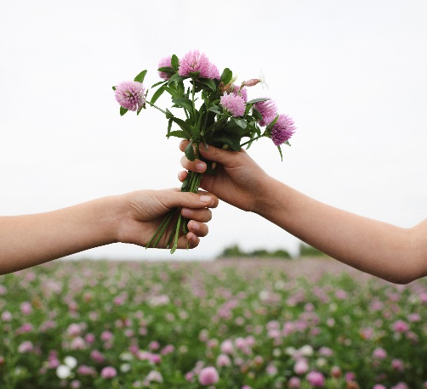
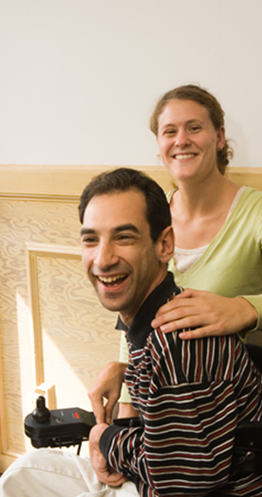
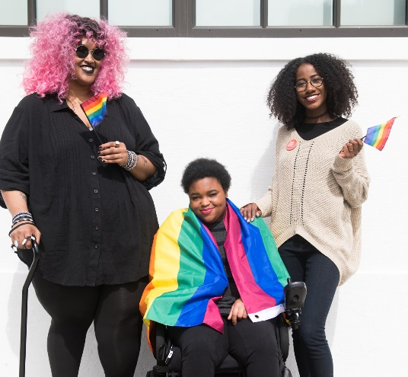
What are benefits of Friendship?
Freely Given
Reciprocal
Grows Over Time
Enduring
Mutual Understanding
Mutual Acceptance
Respect
This Photo by Unknown Author is licensed under CC BY
Notes:
Facilitator Notes Segment 2
This discussion talks about the essence of friendship and what can happens as it begins and grows.
Be sure to emphasize freely given and reciprocal as these are critical elements of genuine friendships.
Reciprocal – The relationship is not one sided, there is give and take, maybe not in the same way but in ways that are valued by each. It might be helpful to ask participants examples of how their own friendships are reciprocal.
“Freely Given” (unpaid/uncompensated by money/grades/course credit, etc) may generate a lot of discussion, especially if the audience is primarily paid staff with long time, close relationships with people they support.
Freely Given
Reciprocal
Enduring
Grows over time
Enduring
Mutual Understanding
Mutual Acceptance
Mutual Respect
Tendency to desire what is best for the other
Sympathy/ Empathy
Mutual understanding and compassion, “Friends ‘get’ you!”
Enjoyment of company, Affection
Ability to be ones’ self and express ones’ feelings
Make mistakes without fear of judgment
Trust & Loyalty

Slide 7
What Are Acts of Friendship?
Sharing
Supporting
Teaching
Sharing
Advocating
Notes:
Facilitators Notes: Segment 3
Friend speaks to the character or personality of the person.
Friendship speaks to the vibrance and growth of the relationship.
Acts of Friendship speaks to the unlimited opportunities to strengthen and deepen a friendship.
Ask the group to look back at the characteristics of friends and friendship and list what “actions” demonstrates their Friendship?
Baby sitting
Helping somebody to move
Lending or giving their friend money
Giving someone a ride
Going on vacation together
Sharing clothes
Teaching a skill – tennis, knitting, skate boarding, playing an instrument.
Helping with homework or a work assignment
Accompanying them to the doctors, interview or making funeral arrangements.
Share with the group that because folks with disabilities are often underestimated in what they understand or can do or lack material resources they don’t often extend acts of friendship but are primarily recipients. Participants can discuss how they can support those they serve to show friendship.
Folks may need help in coming up with ideas but some are as easy as:
making a phone call,
a text or note
Or folks might also need help with supporting a friend by:
walking a friends dog,
raking leaves,
baking cookies,
attending a production or sporting event in which their friend is participating.
All of these fall under the categories under “acts.”

Slide 8
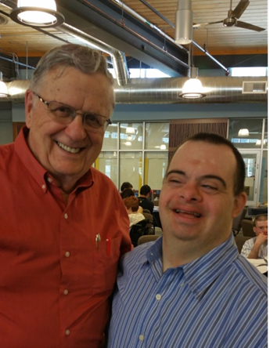
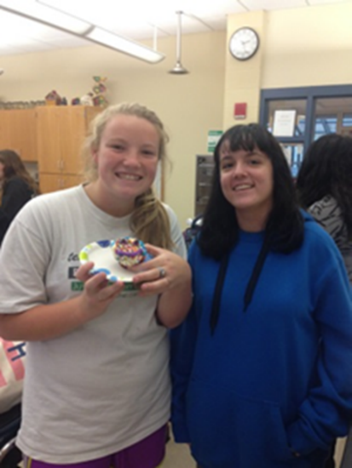
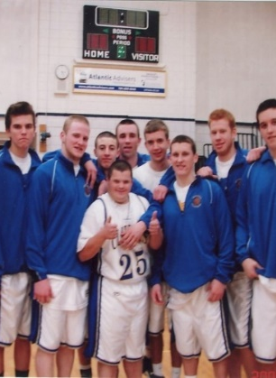
Friendships are critical to our Quality of Life.
People with Friends are:
HAPPIER
HEALTHIER
SAFER
Notes:
Show this slide and talk about the proven benefits of friendship through research and even individual testimonies.
Emotional—Coping effectively with life and creating satisfying relationships
Environmental—Good health by occupying pleasant, stimulating environments that support well-being
Financial—Satisfaction with current and future financial situations
Intellectual—Recognizing creative abilities and finding ways to expand knowledge and skills
Occupational—Personal satisfaction and enrichment from one’s work
Physical—Recognizing the need for physical activity, healthy foods, and sleep
Social—Developing a sense of connection, belonging, and a well-developed support system
Spiritual—Expanding a sense of purpose and meaning in life
Loneliness
You can be surrounded by people but still feel lonely.
You can have few friends but not feel lonely.
The quality of the relationships in one’s life determines whether one feels lonely.
Cardiovascular Disease (poor diet)
Obesity (poor diet/sedentary lifestyle)
Digestive System Problems
Loneliness is associated with:
Depression
Cardiovascular Disease & Obesity
Cognitive Decline
Declines in mobility and daily function
Increased risk of early
death
“A groundbreaking 2010 study from Brigham Young University found that weak social connections can shorten a person’s life by 15 years-- roughly the same impact as smoking 15 cigarettes a day.”
The Loneliness Epidemic; Mattie Quinn, May 2018

Slide 9
Challenges Faced by Support Staff and/or Family Members
Real and perceived “rules” in the “system”
Parental/staff fear of taking risks
Lack of time and/or money
Staff schedule issues
Unfamiliar with the individual’s interests
Unfamiliar with the individual’s community
Unsure of how to support someone in making friends.
Notes:
Facilitator Notes:
This slide relates to anyone who supports folks with disabilities as these hurdles are not uncommon but there may be others that the group is willing to share. The facilitator can either illicit examples from the audience or show this slide for discussion. The intent of this slide is to not only highlight some of the hurdles but to show that some of the biggest hurdles have little to do with the person being supported but more to do with the system, misinformation, lack of expectations and training.
Once identifying these hurdles it’s important to let the audience know that these are not insurmountable and do need to be addressed. Through the remainder of the training, answers will be identified but unless each person is convinced about the importance of friendship and is willing to work on the behalf of folks with disabilities, little will change.
Example

Slide 10
Notes:
Facilitator Notes: The group has spent some time talking and thinking about what we mean by friend, the characteristics of a friendship, and the benefits and challenges to friendships for people with intellectual or developmental disabilities. The remainder of this training will focus on the importance of people belonging/participating in their communities but how friendships can be made and fostered through being engaged in their community.
Community inclusion is a term that most in the audience will be familiar to support people with disabilities. We want to look a little closer at what this phrase means.
You can break the group in two and ask them to come up with words or phrases and report back or if you choose to record responses have two sheets of wallpaper, one with the word community and one with the word inclusion.
Ask folks to share words or phrases that describes what community means to them.
Then share the next slide.

Slide 11
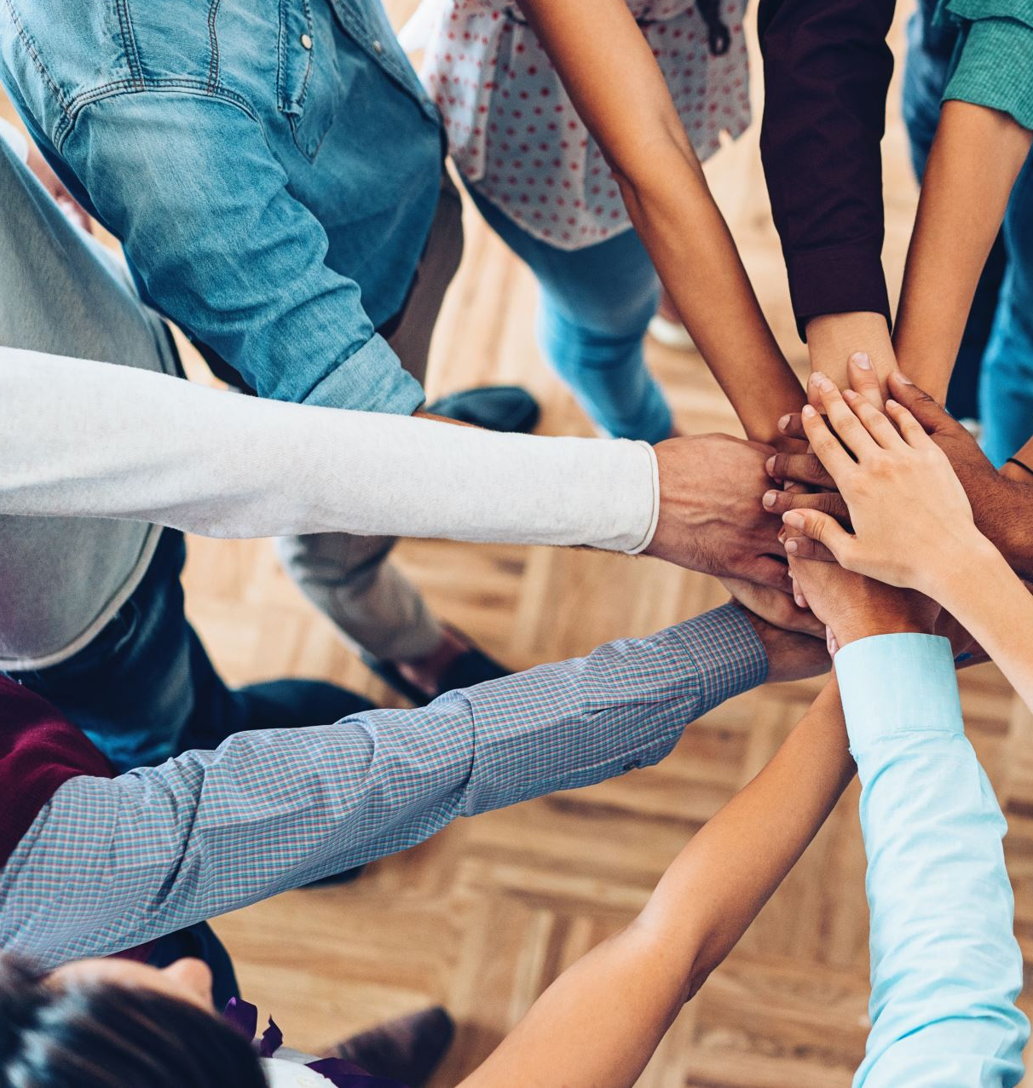
What is a "Community”?
A group of people living in the same place having a feeling of fellowship and sharing common attitudes, interests and goals.
Examples include:
Neighborhood,
Retirement community
Faith community
Sports fans
Notes:
Facilitator Notes: All of these are examples of people being together because of common interests, attitudes or goals. From any of these communities listed there are numerous opportunities for growth, companionship, exploration, adventure, excitement, etc.
One way/avenue for folks with disabilities to meet others and to develop relationships is through communities, groups or individuals who share common interests. For the folks you support “interests” might not be apparent or seemingly don’t exist. This is where partnering and working with family, coworkers, and others is helpful.
Facilitator: From your personal experience, share a story about someone you know who developed relationship through their community. Ask the group for their “take-aways” from your story.
Ask the group to report back or respond to what the word inclusion means to them.
Share the next slide.

Slide 12
What is the meaning of “Inclusion”?
Accepted
Wanted
Valued
Recognized
Feeling secure
Included
Belonging
Being Engaged
Notes:
Facilitators Note:
Review briefly but emphasize that we all want to feel included and we all know what it’s like to be excluded because we have all had a taste of it, if only briefly.
Show the next slide and ask if anyone has other examples.

Slide 13
You know you’re NOT being included if…
If you are set apart
If you are isolated
If you're not invited
If you’re ignored
If you are patronized
Notes:
Facilitators Note:
Some examples are obvious. If your not invited to a party and everyone else is … obvious. For us to actively support folks with intellectual/developmental disabilities or anyone who is marginalized in one way or another it’s important to look acknowledge and respond when this happens and to also be attuned to the more subtle examples.
Let’s take a look at two real-life examples:
COPY to slide 17& 18 presenter notes
Discuss:
What’s wrong?
Who was impacted by the situation?
How were they impacted?
Who could have changed the situation?
Some may think your advocacy is, asking too much but vigilance is necessary to not only move forward but to maintain our ground. Problem solving and working together cultivates understanding, encourages creativity and builds bridges.

Slide 14
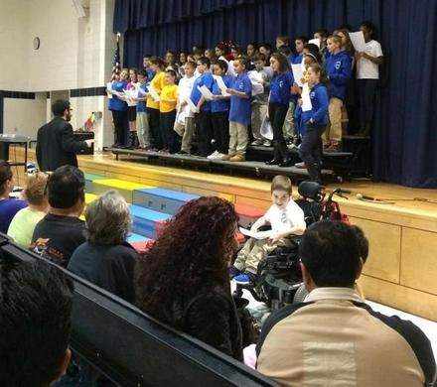
INCLUSION OR ILLUSION ?
Notes:
Use these 2 slides to help participants understand that just being in the same place as others is often not enough. Proximity is NECESSARY for friendships to happen, but proximity, alone, is no guarantee that they will.
Note that the second picture was taken at an event in Fall River in December 2015, not long ago.
Ask participants who could fix this. Answers should include chorus director, parent, other members of the chorus and the boys in the wheelchairs themselves.
You may choose to read the story behind the first photo ( black and white) and then talk about the second photo. In both pictures the parents were emotionally impacted negatively.
You might want to ask how the chorus participants and observers might be negatively impacted even if unconsciously.

Slide 15
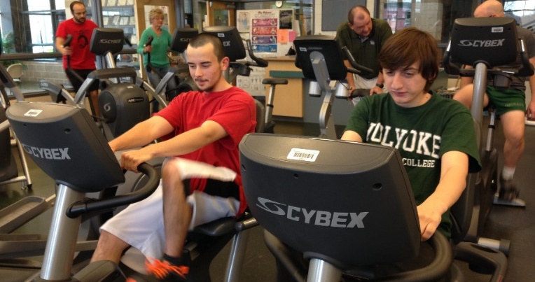
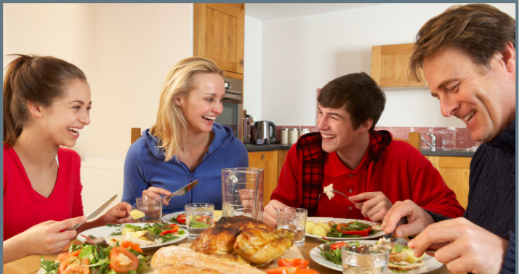
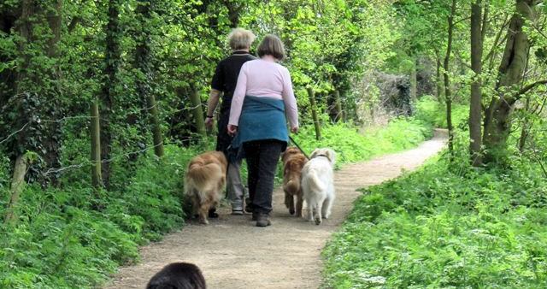
Maximizing Community Connections using local resources
RATE each of the following:
Working out at a local fitness center twice a week.
Eating breakfast at a restaurant once a week.
Volunteering to walk dogs at your local shelter.
1 – Low probability to increase relationships
2 – Medium probability
3 – High probability
What could be done to enhance the chances of developing relationships?
Notes:
One of the “Hurdles” commonly mentioned by both parents and staff is lack of time to devote to social opportunities and friendship making with/for the person they care about. Parents/staff may be caught up in dealing with school systems, doctors’ appointments, etc. If that’s the case—and if people agree that friendships are important—then we need to figure out how to use the little time we have more productively.
Ask participants to team up with one other person. Ask them to follow the directions on the slide to both rate the activity (as to whether or not it is a good way to make friends) and to think of ways that the activity could be improved to increase the chances of friendships developing.
After a few minutes, go through the 4 examples as a large group, asking each pair for input.
Participants will likely have very different experiences regarding fitness centers as places to make friends. Chances of this happening can be increased by:
-going to the same fitness center on the same days and same times each week.
-exercising in classes (zumba, yoga, spinning, etc.) or group activities (basketball, etc.) vs a solitary activity such as treadmill.
-go to the fitness center with another member instead of with a staff person. If a staff person is initially involved, they should “fade” as soon as possible.
Many people connect through a love for animals. This activity could be bettered by:
-volunteering regularly on the same days/times.
-team up with other volunteers from the community. Find out where they live. Can they provide future rides to the shelter?
-can the dog walking take part in the community (dog parks) and not just on the shelter property?
-can dog-walking skills be honed to a point where someone could get a neighborhood job as a dog walker? (someone served by DDS actually started a neighborhood dog-walking business, “K9-5”, after initially volunteering at a kennel!)
“Breaking bread” together is a great way to connect with others. To enhance the chances of friendships:
-locate the neighborhood restaurant where locals are most likely gathering.
-go on the same day(s)/time.
-be sure to chat with wait staff and customers
-STAFF: Role model interactions with the people you support. Let others see them participating in ordering, conversing, etc.
-being a regular customer could lead to a job offer!
4. Voting is a very important activity, but not a good way to meet people. There are many seemingly “one-shot” activities (United Way’s Day of Caring, Project Bread’s Walk for Hunger, numerous fund-raising events, etc.) that we want to encourage people to take part in. But there are some things that can make these events opportunities for friendship:
-voting and other activities have lots of background work. Be part of a campaign to support a candidate/issue; attend meetings, stuff envelopes, make phone calls, hold signs, etc.
-find out if other campaign volunteers live nearby; they may be able to provide transportation/support.

Slide 16
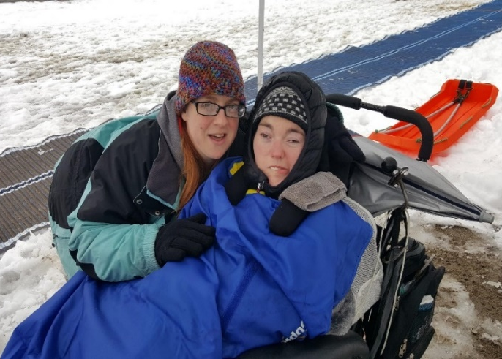
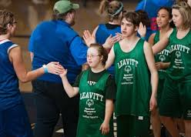
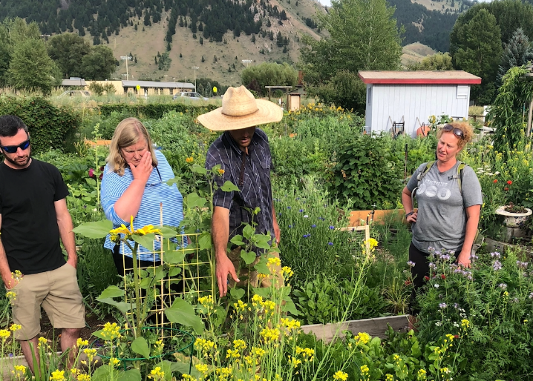
Successful Strategies for Developing Friendship & Belonging
Notes:
The previous discussions focused on the intrinsic value and importance of friendship.
Now lets look at some proven strategies that might be used to help folks with and without disabilities develop friendships.

Slide 17
Strategy #1: Deepen Existing Relationships in Places Already Frequented
Consider where people already spend their time in their community.
Look where people are already comfortable, confident, and known.
Acquaintances could deepen their connection and develop their relationship into a friendship.

Slide 18
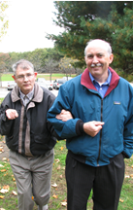
Strategy #2: 1-to-1 Matchmaking
Begin with the person with the disability
Look for a friend/advocate who matches their needs, interests and desires.
Relevant background information is provided about their potential friend
The two potential friends meet as an introduction
Staff take a background role to allow the friendship to blossom

Slide 19
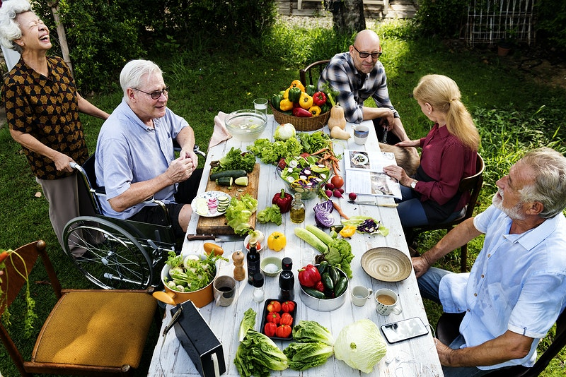
Strategy #3: Connect with People from the Past *Family Friends* Former Neighbors* School mates*Former staff members
Notes:
Consider using social networking sites to locate old friends/neighbors/school mates

Slide 20
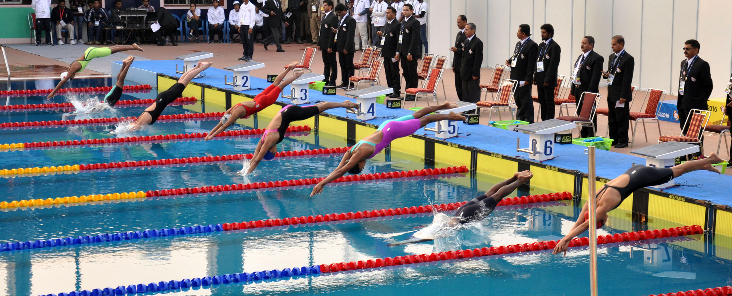
Strategy #4: Become a member of an existing group
Recreational groups in the community open to everyone
Social groups that are integrated
Faith-based groups where all people are welcome
Civic organizations in the community
Notes:
Recreational groups: consider what ROLES a person could hold in a recreational group; perhaps the person supported could volunteer to assist the swim team coach?
Social groups:
Faith-based groups. Surveys show that many people with disabilities have been denied the opportunity to participate in the religion of their choice. And faith-based organizations have a variety of activities within their scope (services, choir, childcare, social events, community service, adult bible study, etc.) in which people with and without disabilities can connect.
Needs-based groups: Support groups such as Alcoholics anonymous or Weight Watchers are open to everyone and could be beneficial to people we support who struggle. Anyone who has suffered the loss of a loved-one needs time to grieve. They may benefit from attending a bereavement support group.

Slide 21
Strategy #5: Learn new skills or seek new knowledge in Community settings
Improve skills in an adult-education class at the local HS or Community College.
Ensure the location is integrated in the community where all people are welcome.

Slide 22
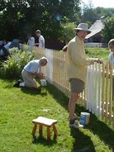
Strategy #6: Connect with your neighbors
*Host neighborhood events
*Welcome new neighbors with cookies
*Volunteer to shovel snow or mow lawns
*Do errands for elderly neighbors
*Just sit and chat!
*Share your garden flowers or vegetables
Notes:
DON’T emphasize differences from neighbors (such as hosting cookout and inviting other group homes)

Slide 23
Notes:
And everyone deserves that.
Questions?

Slide 24
Additional Resources
“Friends: Connecting People with Disabilities and Community Members”, by Angela Amado at https://ici.umn.edu/products/docs/Friends_manual.pdf.
“How to Build Relationships” by Al Condeluci listed on Widening the Circle’s “How To…” webpage at http://thearcofmass.org/programs/widening-the-circle/how-tos/.
150 THINGS YOU CAN DO TO BUILD SOCIAL CAPITAL: Social capital is built through hundreds of little and big actions we take every day. We've gotten you started with a list of nearly 150 ideas, drawn from suggestions made by many people and groups. Try some of these or try your own. https://www.hks.harvard.edu/saguaro/whatyoucando.htm
Widening the Circle’s website at http://thearcofmass.org/programs/widening-the-circle.
Meetup (https://www.meetup.com/
Bridges to Faith/New Bedford (www.bridgestofaith.org)
Spiritual Connections/Fall River (http://peopleinc-fr.org/programs/spiritual-connections/)
Club 21 (https://alternativesnet.org/ways-to-help/be-an-ambassador/club-21/)
Citizen Advocacy (https://www.nqcitizenadvocacy.org/)
Community of Friends (www.betacomm.org). Beta community Partnerships has been matching adults they support with volunteer members of their communities, based on shared interests
Big Brother/Big Sister (https://www.bbbs.org)
Joining a group resource: https://Onlyinyourstate.com

Slide 25
This Curriculum Prepared and Developed through Widening the Circle Expanding opportunities for friendships between people with and without disabilities http://thearcofmass.org/programs/widening-the-circle/ A partnership between the Arc of Massachusetts & the Massachusetts Department of Developmental Services
Notes:
Resources
Your Local DDS-Funded Family Support Center (http://www.disabilityinfo.org/mnip/db/tacr/OfficeByAgency.aspx?id=21) Your Local Chapter of The Arc (www.thearcofmass.org) Your Closest Chapter of MA Network of Information Providers (http://disabilityinfo.org/Resources/MNIP/members/) Index (www.disabilityinfo.org) Widening the Circle Website (http://thearcofmass.org/programs/widening-the-circle/)
Friendship and the IEP (Page 12 at http://thearcofmass.org/wp-content/uploads/2014/09/Advocate04.16.pdf)
Friendship and the ISP (Page 4 at https://issuu.com/thearcofmassachusetts/docs/advocate07.16)
Friendship and PCP (will be available in the Fall 2016 Arc of MA newsletter, Advocate)
Friends at Work Toolkit (http://thearcofmass.org/building-friendships-at-work-toolkit/)
Friends at School Toolkit (available at the Arc of MA after 1/1/2017)
Friends Where You Live Toolkit (available at the Arc of MA by 6/30/2017)

